Slide 1
Module 10: Exceptions

Slide 2
Module Objectives (1 of 2)
10.1 Defining Exceptions
10.1.1 Explain the use of exceptions being raised in situations where the computer cannot continue.
10.1.2 Define an exception as a triggered event.
10.1.3 Describe the difference between a logic error (can be found by reading the code) and a runtime error.
10.1.4 Define exception objects as packages of information about what happened.
10.1.5 Contrast default exceptions with specific exception types.
10.1.6 Explain that different types of exceptions represent different general errors.
10.1.7 Explain that certain languages have defined exception types.
10.2 Dealing with Exceptions
10.2.1 Explain trying and error handling as logical flow controls.
Notes:
Instructions: Briefly review with students the major concepts you will be covering during this class. There are several objectives for every major A-Head section of the chapter.

Slide 3
Module Objectives (2 of 2)
10.2 Dealing with Exceptions (continued)
10.2.2 Explain how code can try to achieve something.
10.2.3 Explain what happens when the code within a try block fails.
10.2.4 Explain how to use catching for error handling.
10.2.5 Describe the difference between a general except statement and exception specific statements.
10.2.6 Explain good design for including statements in the try block.
10.3 Using Exceptions
10.3.1 Discuss the advantages and disadvantages of exception handling versus robust code.
10.3.2 Explain statements that cause exceptions.
10.3.3 Describe the best practices for adding exceptions to a program.
10.3.4 Trace the flow of execution through variations of try block statements.
Notes:
Instructions: Briefly review with students the major concepts you will be covering during this class. There are several objectives for every major A-Head section of the chapter.

Slide 4
10.1 Defining Exceptions (1 of 4)
Errors in code
General types of errors
Logic errors: errors in code that do not prevent the code from running and/or producing output but result in incorrect behavior and/or output
Semantic errors: errors caught by the compiler
Runtime error: a flaw in the program that causes it to fail during execution
Exception: an unexpected event that occurs as the program runs and prevents the program from completing execution
Also used to refer to the interruption triggered by the unexpected event
Also used to refer to a package of information indicating what went wrong (e.g., a numerical code, string description, or more complicated bundle of information)

Slide 5
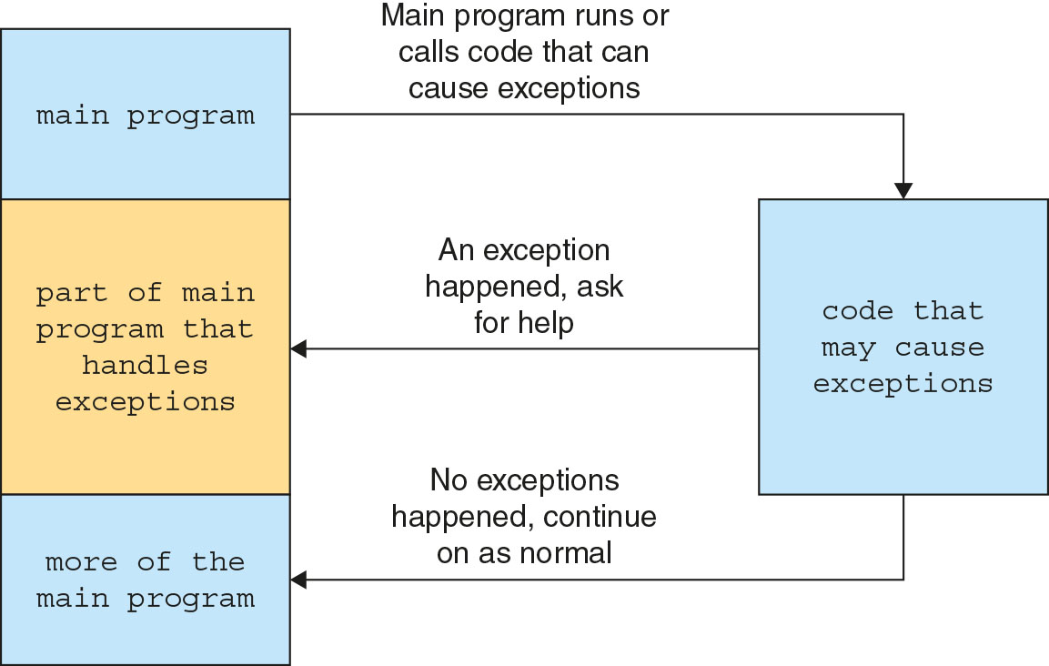
10.1 Defining Exceptions (2 of 4)
Figure 10-2 Communication between normal code and code with exceptions

Slide 6
10.1 Defining Exceptions (3 of 4)
Exception types
Default exceptions: nonspecific or general exceptions provided by programming languages that can be used for all problems, but don't provide context that would help solve the problems
Specific exceptions: exceptions that represent specific kinds of errors
They tell programmers the type of problem that happened, allowing them to find solutions faster
Many specific exceptions, which differ by programming language, are available
Most languages allow you to create your own exception types for special situations or to provide extra information about an error

Slide 7
10.1 Defining Exceptions (4 of 4)
Type | Situation | Example
IndexError | An index is outside an appropriate range | numbers = [] numbers[2]
NotImplementedError | A function or method was not implemented but other program code attempts to run it | nonexistent_function()
RuntimeError | An error happens that does not fit any other exception type | set_color("cat")
TypeError | A function or method is given an argument that has an incorrect type | square_root("cat") set_name(5)
ValueError | A function or method is given an argument that has an incorrect value | square_root(-5) set_age(-12)
ZeroDivisionError | An attempt to divide by zero was made | x = 4 / 0
Figure 10-3 Common exceptions
Notes:
Figure 10-3 Common exceptions

Slide 8
10.2 Dealing with Exceptions (1 of 6)
Handling others’ exceptions
Programmers make their code raise exceptions when certain conditions are true
Generally, to work with exceptions, programs try to do something and catch any exceptions that were thrown in the code
Try and except blocks
Try-except block (a.k.a. try-catch block): a program flow control used for trying and catching exceptions that consists of two parts: the try block and the except block
The try code attempts to proceed as if conditions are normal and nothing disrupts the program flow
If an exception is thrown in the try block, the program flow moves to the except block
Unlike an if-else statement, a try block stops executing code when it detects an exception; the except block may or may not allow execution to resume

Slide 9
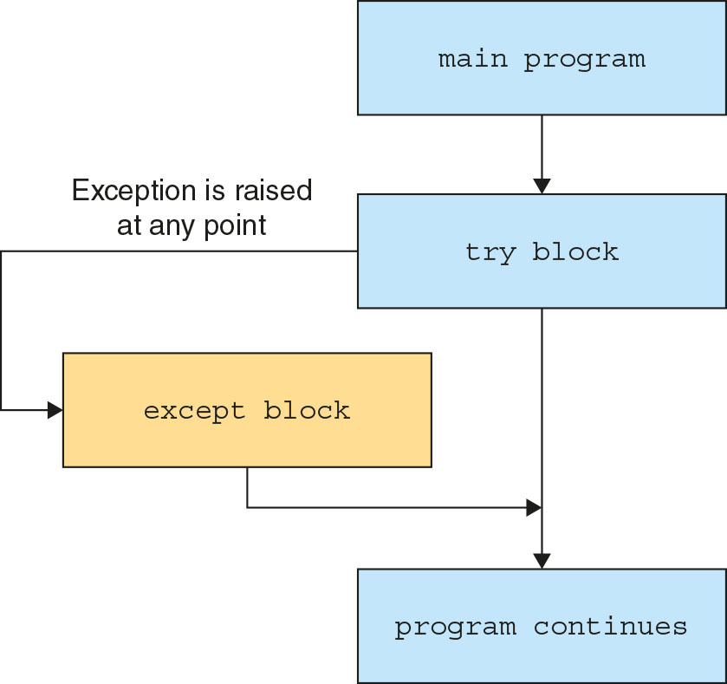
10.2 Dealing with Exceptions (2 of 6)
Figure 10-4 Try-except block logic flow

Slide 10
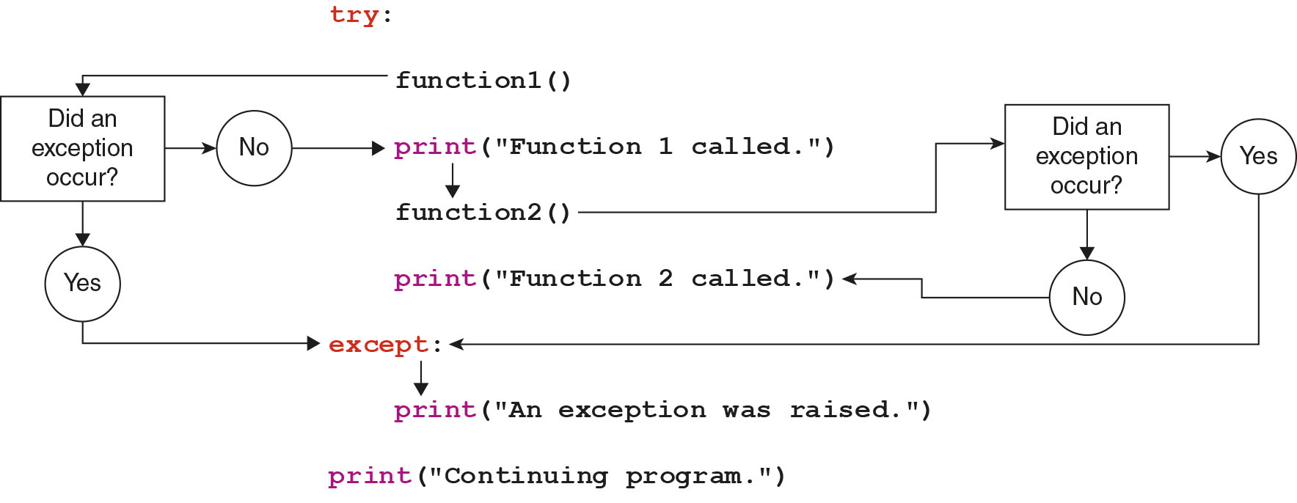
10.2 Dealing with Exceptions (3 of 6)
Figure 10-5 Python code flow example

Slide 11
10.2 Dealing with Exceptions (4 of 6)
Try and except blocks (continued)
Sample try-except block using a default exception:
from PIL import Image cat_image = None try: cat_image = Image.open("cat.png") cat_image.show() except: print("Could not display a cat picture.")
Sample try-except block using a specific exception:
from PIL import Image cat_image = None try: cat_image = Image.open("cat.png") cat_image.show() except FileNotFoundError: print("Could not find the cat picture file.")

Slide 12
10.2 Dealing with Exceptions (5 of 6)
Try and except blocks (continued)
Sample try-except block with multiple except statements (one per anticipated exception type): from PIL import Image, UnidentifiedImageError cat_image = None try: cat_image = Image.open("cat.png") cat_image.show() except FileNotFoundError: print("Could not find the cat picture file.") except UnidentifiedImageError: print("Could not identify the picture format.")
Professional program design tries to keep only the lines of code that rely on exception-raising functions in the try block

Slide 13
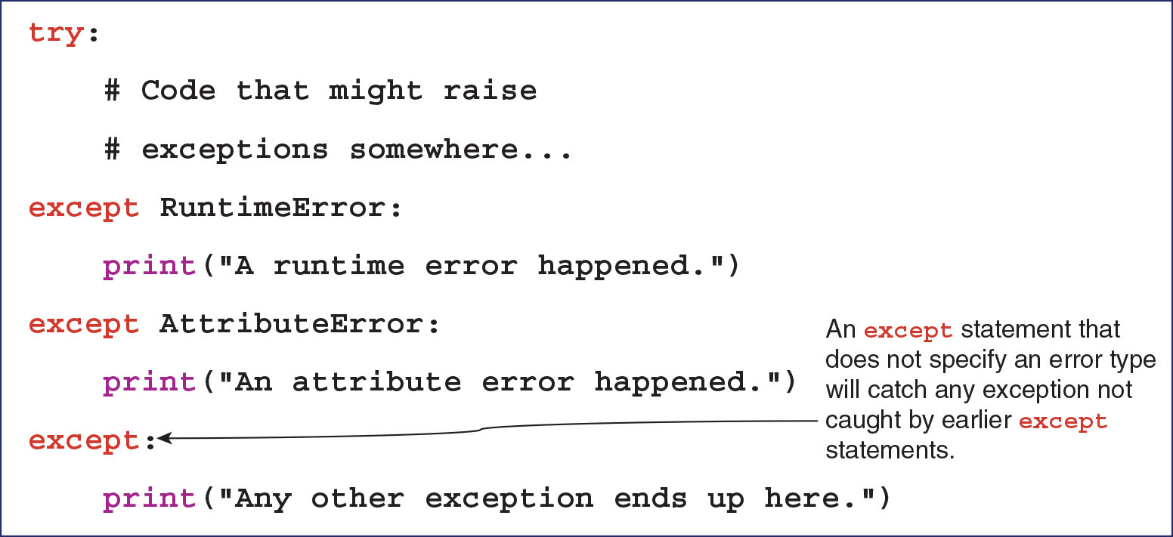
10.2 Dealing with Exceptions (6 of 6)
Figure 10-13 General syntax for try-except blocks

Slide 14
Activity 10.1: Knowledge Check
A robust, well-written program checks for _____ and then responds to them appropriately so that it can detect and manage unexpected errors without coming to a halt.
True or False: Using default exceptions makes it easier to catch a problem but harder to know how to fix it.
In Python, you can use a program control flow called a(n) _____ that attempts to proceed as if conditions are normal but jumps to a different section of the program if an exception is raised.
A program can include multiple _____ statements, one for each exception you expect the program to raise, and the first of these that matches the error condition will be selected.
Notes:
Instructions: Use the Knowledge Check questions to periodically pose a question to students during class to gauge how well they can recall the material that was presented.

Slide 15
Activity 10.1: Knowledge Check Answers
A robust, well-written program checks for _____ and then responds to them appropriately so that it can detect and manage unexpected errors without coming to a halt. Answer: exceptions
True or False: Using default exceptions makes it easier to catch a problem but harder to know how to fix it. Answer: True
In Python, you can use a program control flow called a(n) _____ that attempts to proceed as if conditions are normal but jumps to a different section of the program if an exception is raised. Answer: try-except block
A program can include multiple _____ statements, one for each exception you expect the program to raise, and the first of these that matches the error condition will be selected. Answer: except
Notes:
Instructions: Use the Knowledge Check questions to periodically pose a question to students during class to gauge how well they can recall the material that was presented.

Slide 16
10.3 Using Exceptions (1 of 4)
Raising exceptions
A raise statement is used to raise an exception when a certain condition is met
When it executes, the program immediately stops your code and returns to where it was invoked with the exception information
Sample function that raises a specific exception for invalid user input: def add_cream(amount): if amount < 0: raise ValueError("Cannot add negative amounts of cream.") global cream_amount cream_amount += amount print("Thanks for the", amount, "cups of cream!")

Slide 17
10.3 Using Exceptions (2 of 4)
Raising exceptions (continued)
Another sample function that raises specific exceptions for invalid user input: def make_ice_cream(): global cream_amount global ice_amount if cream_amount <= 0: raise RuntimeError("Not enough cream to make ice cream.") elif ice_amount <= 0: raise RuntimeError("Not enough ice to make ice cream.")

Slide 18
10.3 Using Exceptions (3 of 4)
Raising exceptions (continued)
Sample try-except block using the as keyword to integrate error messages into code: try: if choice == 1: make_ice_cream() elif choice == 2: amount = int(input("How much?> ")) add_cream(amount) elif choice == 3: amount = int(input("How much?> ")) add_ice(amount) except Exception as e: error_message = str(e) print(error_message)

Slide 19
Activity 10.2: Breakout Groups: Make Iceabella Less Exceptional (1 of 3)
Form groups of two to four students.
Modify the program in Figures 10-16 and 10-17 so that it handles one or more of the problems that currently raise an exception in some other way that does not make the program user’s experience worse.
Try out your program with different inputs to confirm that the adjustments work as expected.
Notes:
Instructions:
Use the Breakout Groups Activity to encourage students to solve problems collaboratively and to apply the real-world skill of evaluating, modifying, and debugging code created by another programmer.

Slide 20
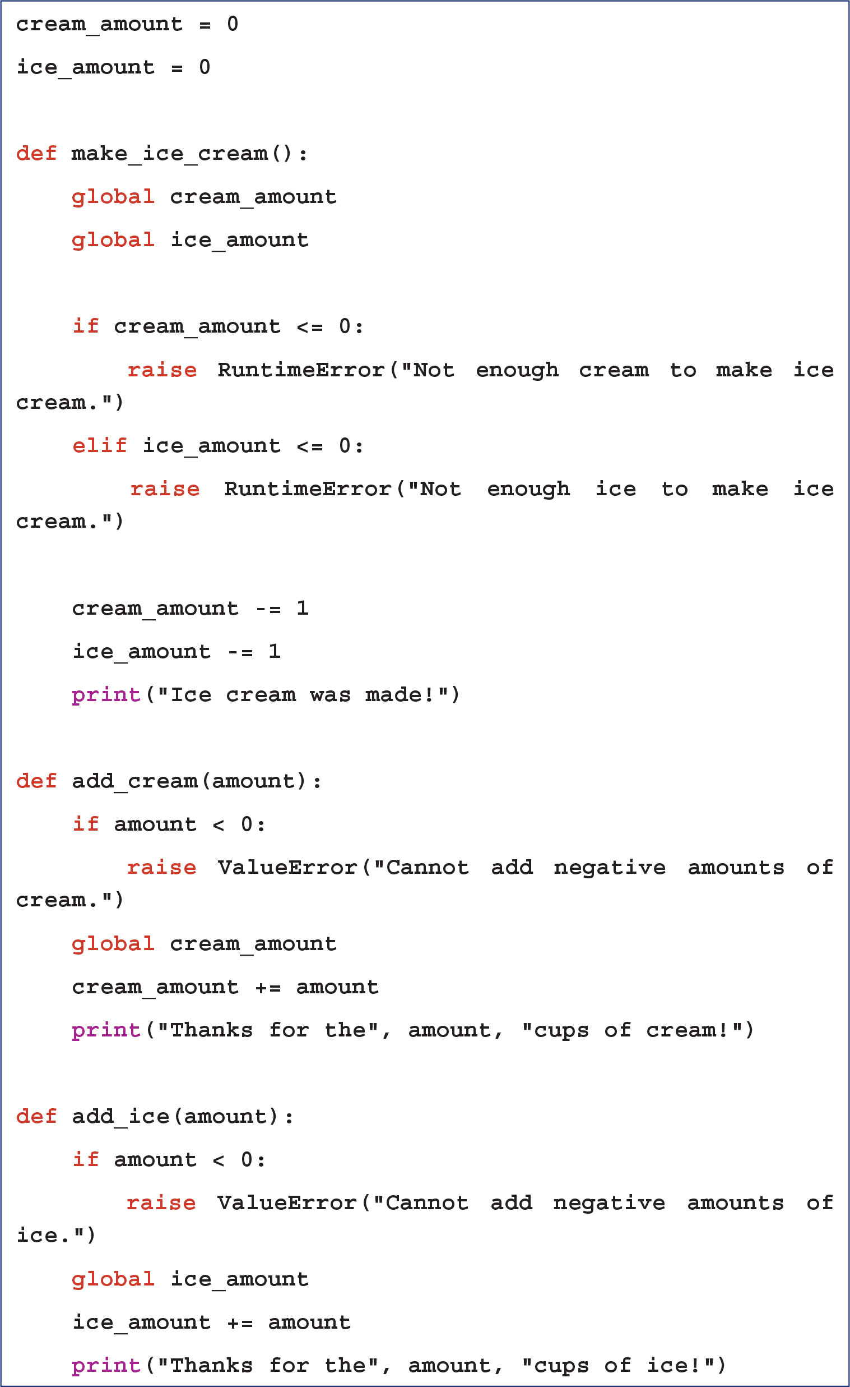
Activity 10.2: Breakout Groups: Make Iceabella Less Exceptional (2 of 3)
Figure 10-16 Adding an exception to the make_ice_cream() function
Notes:
Instructions:
Use the Breakout Groups Activity to encourage students to solve problems collaboratively and to apply the real-world skill of evaluating, modifying, and debugging code created by another programmer.

Slide 21
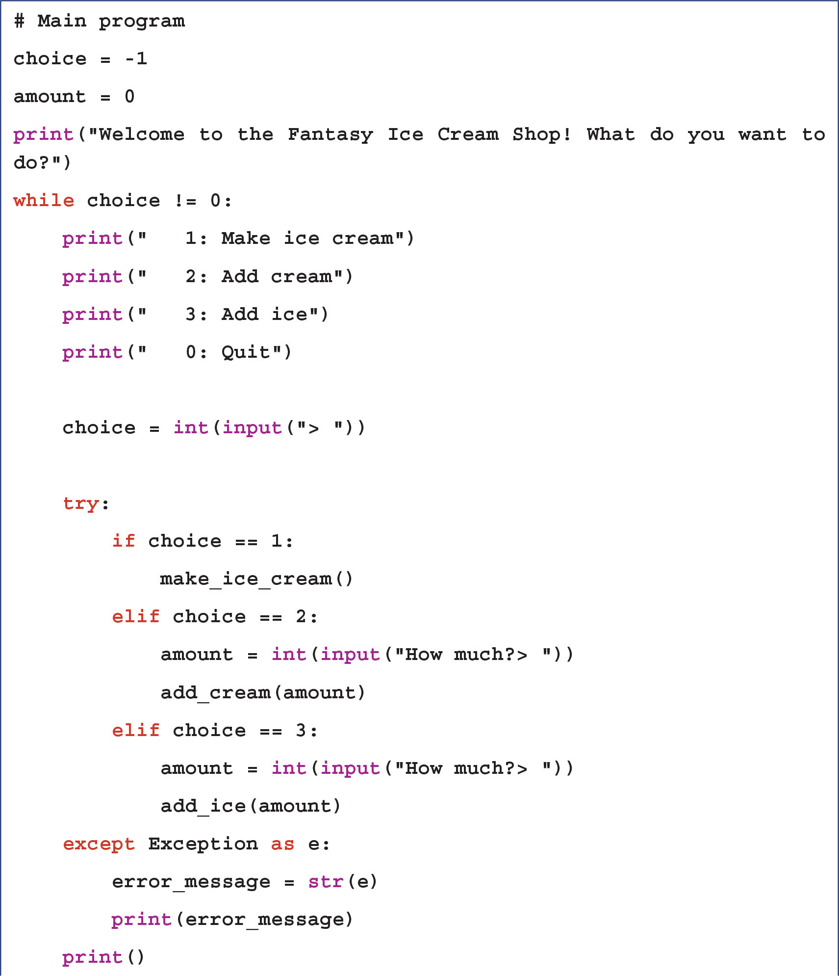
Activity 10.2: Breakout Groups: Make Iceabella Less Exceptional (3 of 3)
Figure 10-17 Main Iceabella program
Notes:
Instructions:
Use the Breakout Groups Activity to encourage students to solve problems collaboratively and to apply the real-world skill of evaluating, modifying, and debugging code created by another programmer.

Slide 22
Activity 10.3: Breakout Groups: Make Iceabella More Exceptional
Form groups of two to four students.
Imagine another problem you think the program in Figures 10-16 and 10-17 is likely to encounter while it is running.
Modify the original program so that it throws another specific exception when this problem occurs.
Test the program to confirm that the exception is raised in response to the intended trigger.
Notes:
Instructions:
Use the Breakout Groups Activity to encourage students to solve problems collaboratively and to apply the real-world skill of evaluating, modifying, and debugging code created by another programmer.

Slide 23
10.3 Using Exceptions (4 of 4)
When to bail
Exceptions allow you to “bail out” of a piece of code that reaches a situation it can’t complete
When to use an exception is generally up to the programmer
A general guideline is to raise an exception when the provided input makes a request impossible—i.e., when assumptions are broken
Overly frequent exceptions might indicate a flaw in the program design or assumptions being made
For libraries, raising exceptions only when code cannot continue keeps code focused on its own goals while leaving other goals to other parts of the program

Slide 24
Activity 10.4: Knowledge Check
A common method for raising exceptions is to use if and/or elif statements placed within _____ that raise when a certain condition is met.
True or False: Well-designed functions typically throw exceptions on more than half the occasions when they are called.
Notes:
Instructions: Use the Knowledge Check questions to periodically pose a question to students during class to gauge how well they can recall the material that was presented.

Slide 25
Activity 10.4: Knowledge Check Answers
A common method for raising exceptions is to use if and/or elif statements placed within _____ that raise when a certain condition is met. Answer: functions
True or False: Well-designed functions typically throw exceptions on more than half the occasions when they are called. Answer: False
Notes:
Instructions: Use the Knowledge Check questions to periodically pose a question to students during class to gauge how well they can recall the material that was presented.

Slide 26
Activity 10.5: Discussion
Review the common specific exceptions listed in Figure 10-3. Which of these exceptions would you expect to be raised by code that receives and works with user input? By code that interacts directly with other code but not with human users?
Identify the types of control structures used in the “Iceabella” program discussed throughout Module 10. How is the try-except block similar to and different from the other control structures? Which control structures are nested within other program components?
Notes:
Instructions:
Use the Discussion activity to encourage group conversation about a related topic of interest.

Slide 27
Self-Assessment
Have you noticed exceptions being raised by programs you have run as a user? If so, what do you remember about the experience and/or the types of errors that caused the exceptions to be raised?
What is your perspective regarding when to raise exceptions versus when to write logic to handle problems gracefully without interrupting program flow?
Notes:
Instructions: Use the Self-Assessment question to encourage students to evaluate their progress or goals in the course, as well as determine how they might apply their learning or grow as an individual.

Slide 28
Summary
Click the link to review the objectives for this presentation.
Link to Objectives
Notes:
Instructions:
Reiterate the learning objectives for the lesson. Students should use this information to guide their studies and reinforcement of new concepts.

